Slide 1




Hexaware CODE&RISE PROGRAM
AVANYA_VELAMMAL_INST
Innovation Unleashed with Avanya

Slide 2
Team Details
Team Name : AVANYA_Velammal_Inst
Application Name : Softskills Enhancement(Soft Dojo)
Team Members
Email ID
MALLU NAVYA
mallunavyareddy@gmail.com
ITHA VAISHNAVI SANJUKTHA
ithavaishnavi15@gmail.com
PAGALA SWETHA
pagalaswetha11@gmail.com
KAMIREDDY BHAVANI
nanikamireddy3@gmail.com
…
…

Slide 3

Impact/Potential Value of the Application
Improved Communication Skills
Increased Employee Confidence
Streamlined Onboarding Process
Enhanced Employee Retention
Data-Driven Insights for HR
Cost-Effective Training Solution

Slide 4
The Solution Proposed by your Team
Solution Highlights
Key Features / Approach
Developing a cross-platform mobile application (iOS and Android) using a framework like Flutter or React Native to ensure broad accessibility and consistent user experience across devices.
It allow users to register using company email or integrate single sign-on (SSO) with the company’s HR system.
Using AI to create personalized lesson plans based on the initial assessment results and user profile information.
It includes quizzes and tests at the end of each module to evaluate user progress.
It Implement end-to-end encryption to protect user data during transmission and storage.
Seamlessly integrate with existing HR software to automate user onboarding and track employee progress.
It Offer 24/7 customer support for users experiencing issues with the app.
Cross-Platform Accessibility
User Registration and Integration with HR Systems
AI-Powered Personalized Learning Paths
Interactive Quizzes and Tests
Data Security and Privacy
Integration with HR Software
24/7 Customer Support

Slide 5
Technologies Used
Cross-Platform Development Framework (Flutter or React Native):These frameworks allow for the development of mobile applications that work on both iOS and Android platforms
Single Sign-On (SSO) and HR System Integration: SSO technology is used to integrate the app with the company’s HR system
Artificial Intelligence (AI): AI is employed to create personalized lesson plans.
Quiz and Test Module: This module uses various technologies to create interactive quizzes and tests at the end of each learning module
End-to-End Encryption: Encryption technologies are implemented to protect user data during transmission and storage
Customer Support System: A customer support system, potentially powered by AI chatbots and a ticketing system, is available 24/7

Slide 6
Gen AI Tool Utilization
Utilization of GPT in the Proposed App
1) Personalized Lesson Content Generation:
Dynamic Content Creation: Quizlet’s AI-powered tools can be leveraged to generate personalized lesson content based on the initial assessment results and user profiles.
Adaptive Learning Paths: Using Quizlet’s AI-powered tools, the app can create a dynamic learning path that adapts as the user progresses.
2) Interactive Quizzes and Test Creation:
Custom Quizzes: Kahoot! With AI-based question generation can generate quizzes and tests based on the user's progress and the content covered in previous lessons
Contextual Feedback: When a user answers a quiz or test question, Kahoot! With AI-based question generation can provide immediate, context-sensitive feedback.
3) Conversational Practice and Speech Recognition:
Real-Time Conversational Practice: Duolingo can simulate real-time conversations
4) Continuous Learning Support and FAQ Generation:
24/7 Assistance: Tidio can be used to power a virtual assistant or chatbot within the app, providing users with 24/7 support.

Slide 7
System Architecture, Functionalities and Design Diagram
Data Flow and Processing Steps
User Registration and Authentication
Lesson Delivery and Progress Evaluation
Data Security and HR Integration
Components and Their Interactions
Mobile Application
Backend Server
AI Engine
HR System Integration
Data Pipeline, API, and External Services
Authentication API
AI Services (like GPT)
Encryption Services

Slide 8
How it works
Functional Architecture
User Registration & Login
Initial Assessment
Learning Path & Content Delivery
Progress Tracking
Data Encryption
y

Slide 9
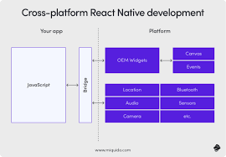
How It Works
Technical Architecture

Slide 10
Innovation and Creativity
Cross-Platform Compatibility
Seamless User Authentication
AI-Driven Personalization
Comprehensive Progress Evaluation
Robust Data Security
Integrated HR Solutions

Slide 11
Scalability, Performance and Security
Scalability
Modular Architecture Design
Cloud-Based Infrastructure
Adaptive User Load Management
Performance
Optimized Cross-Platform Codebase
Real-Time Data Processing
Efficient Resource Management
Security
End-to-End Data Encryption
Secure Authentication Mechanisms
Regular Security Audits and Updates

Slide 12
Best practices and industry standards followed
Utilizing Flutter or React Native to develop the application, ensuring it works smoothly on both iOS and Android platforms.
It Allows users to sign up using their company email, ensuring that only authorized personnel have access to the app.
It Uses AI to analyze initial assessment results and user profile information to create tailored learning experiences.
Includes interactive quizzes and tests at the end of each module to evaluate user understanding and retention of the material.
It Ensures that all user data is encrypted during transmission and storage, protecting sensitive information from unauthorized access.
It Integrates with existing HR software to automate user onboarding processes, reducing administrative overhead and ensuring a smooth user experience.
Offers round-the-clock customer support to assist users with any issues they may encounter, enhancing user satisfaction and retention.

Slide 13
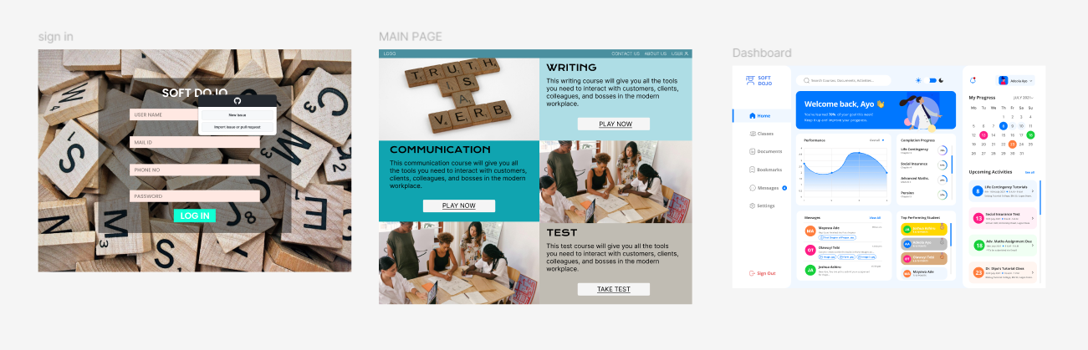
User Experience

Slide 14
Console Output Details
The link to the GitHub repository containing our solution :
https://github.com/MalluNavya/Avanya_Hexaware.git

Slide 15
Thank You

